Slide 1
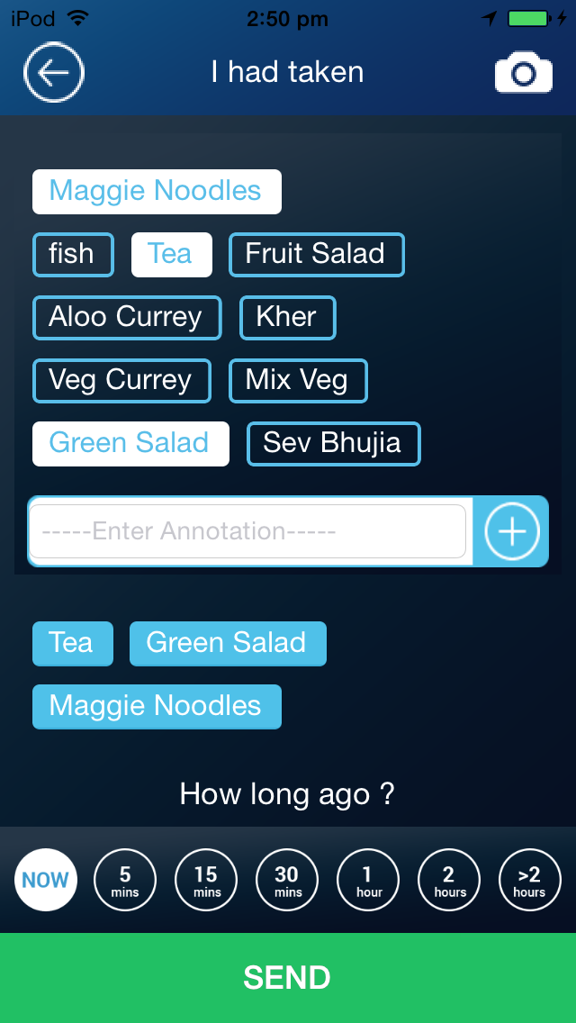
Notes:
No comment

Slide 2
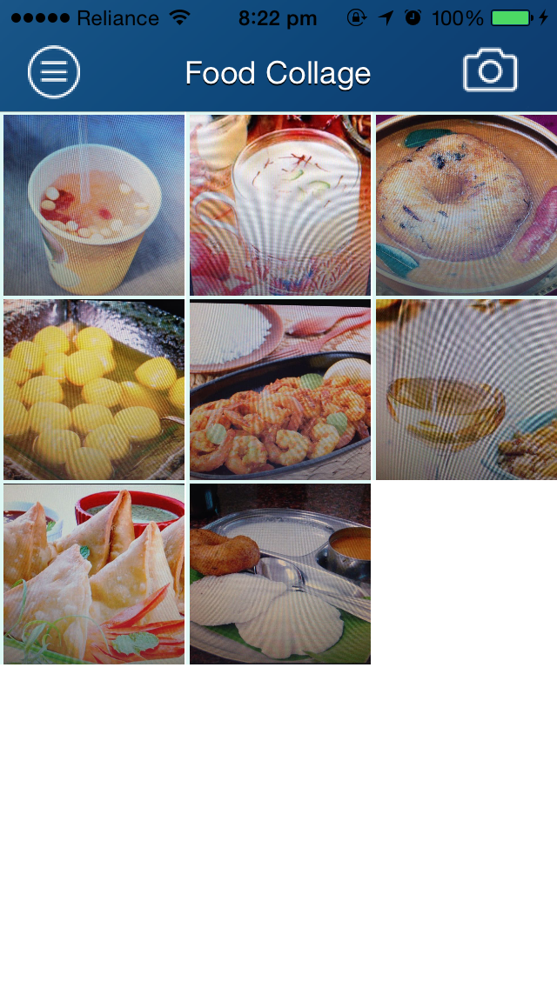

Slide 3
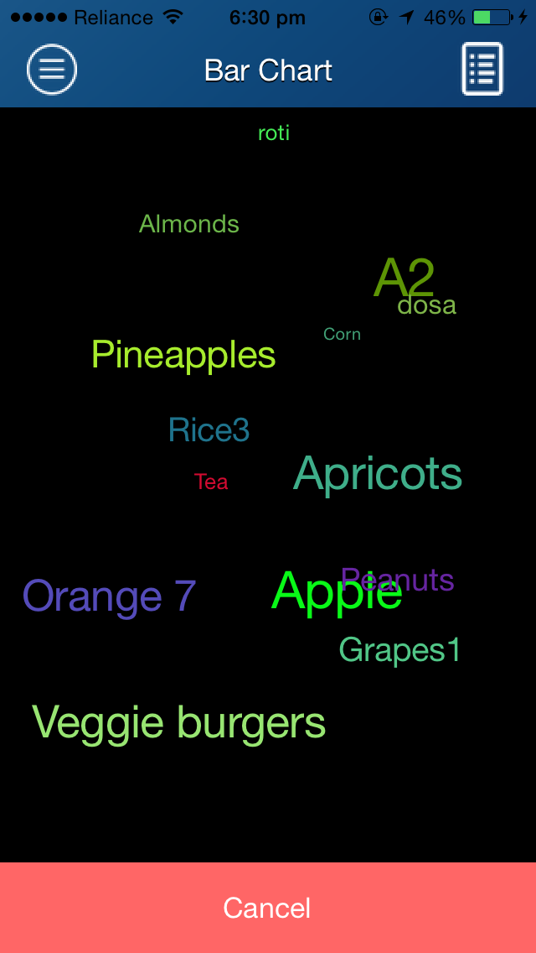
Menu medley

Slide 4
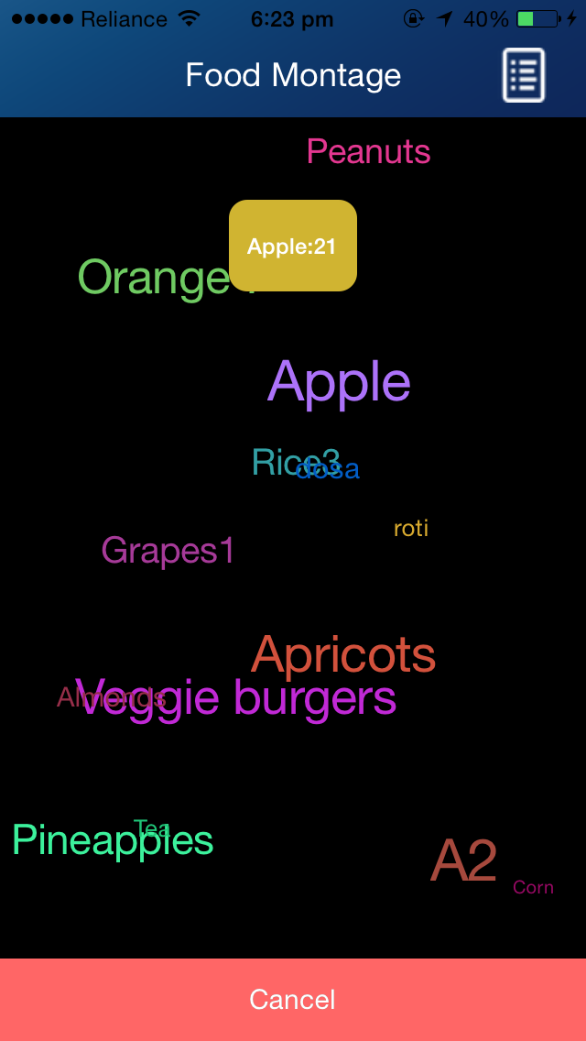
Notes:
I liked the shape of the cluster with the smaller one, all over the screen looks messy and so far apart difficult to say if items are larger than others.

Slide 5
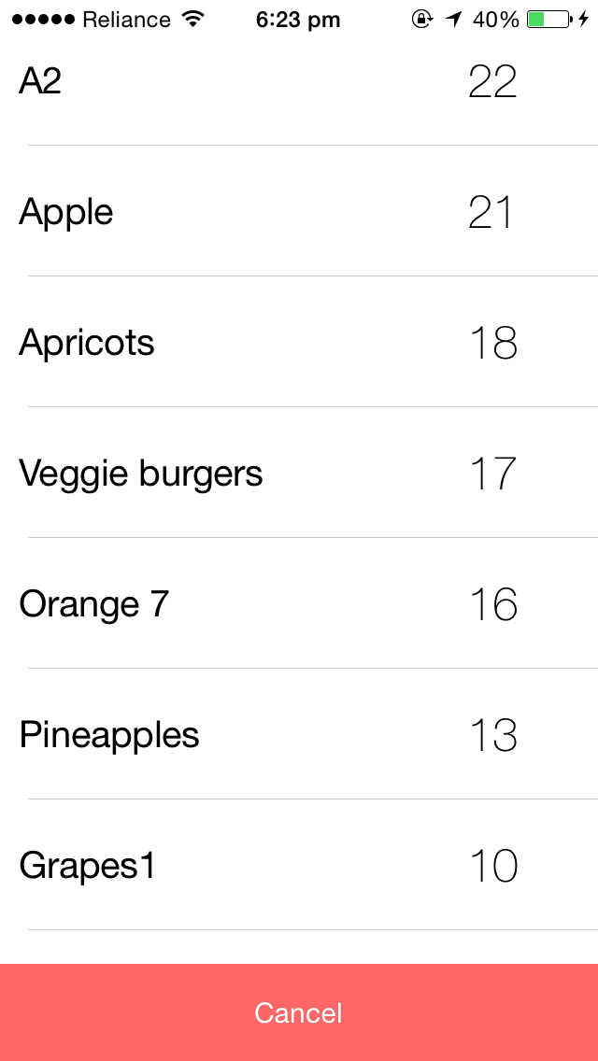
Notes:
I like the idea of this under the Menu Medley and if really long can just scroll down.

Slide 6
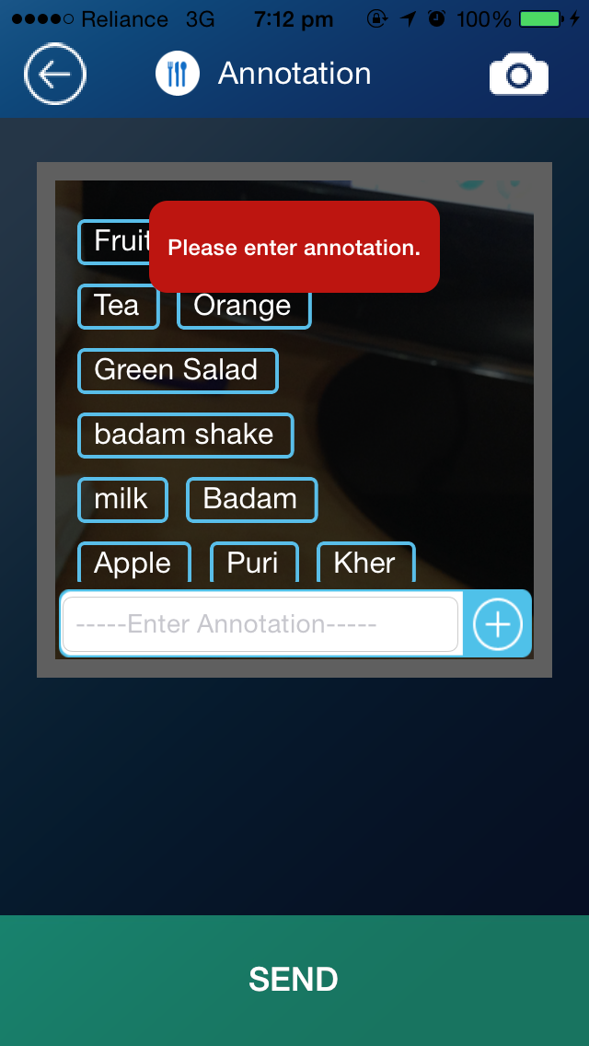

Slide 7
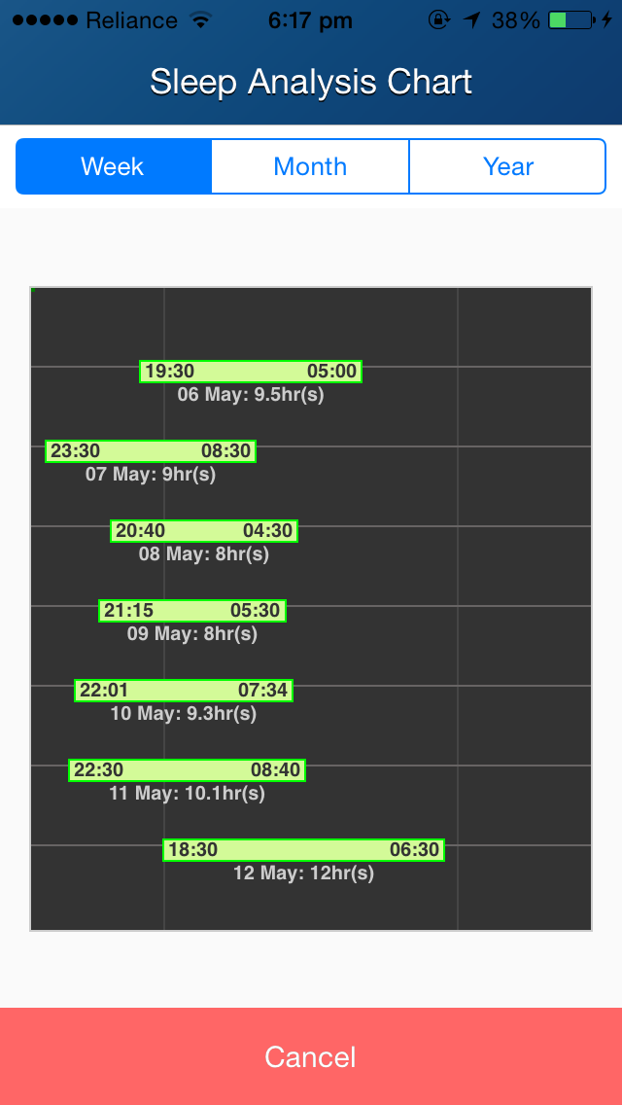
Time axis
Showing 2 weeks data will be nice as people can see the weekend changes clearly.
Need to show set target, sleep duration during weekday and weekends and weekend jetlag. Just like the eating duration part in feedogram
Notes:
When we talked prior you said you were going to take out the “jetlag,” if still on there we need to create a FAQ.

Slide 8
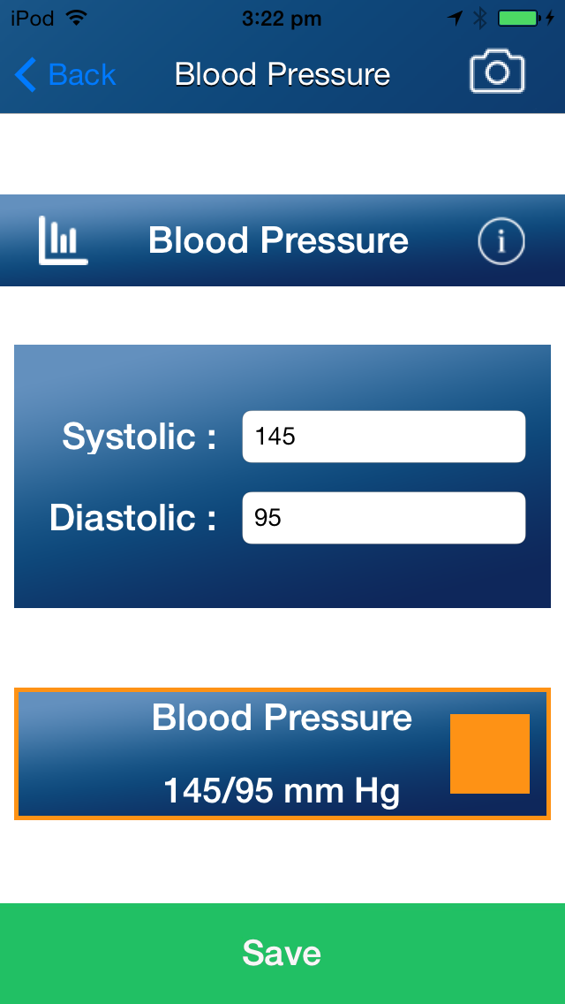
Is it possible to implement a scale bar like this for BMI, Blood Pressure, fasting blood glucose etc.? It might show relative risk/healthiness on the same screen.
Add the info for blood pressure ; just like in BMI. Mandy will send text.
Number wheels for data input. The current in put style does not have an “Enter” button.
What is this “save” for.? If you implement the number wheel, put the save button next to it.
120
139
159
80
89
99
Notes:
Could have key under 145/95mm Hg that shows risk level of color like Red is hypertension level, yellow is prehypertension, and green desired level. Or if don’t want on same screen can hit the yellow bar and see this come up.

Slide 9
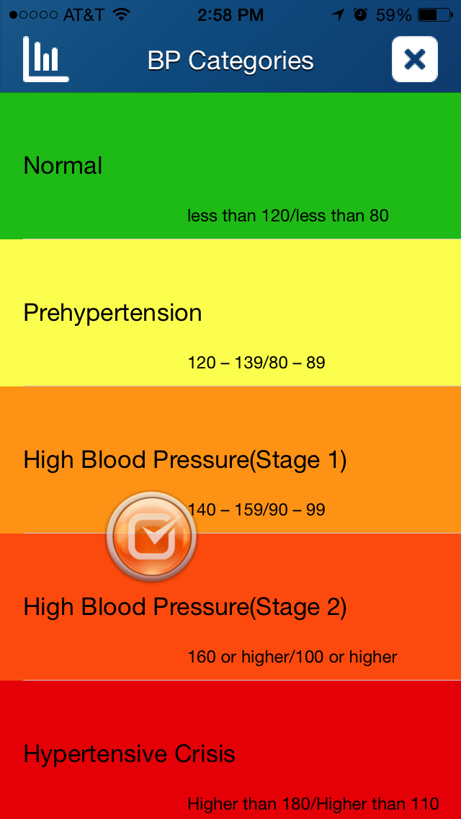
Change to “Blood Pressure Ranges”
Please refer to wiki page
http://en.wikipedia.org/wiki/Blood_pressure and use the following table for reference ranges
Classification of blood pressure for adults[1][2]
Category | systolic, mm Hg | diastolic, mm Hg
Hypotension | < 90 | < 60
Ideal | 90–119 | 60–79
Prehypertension | 120–139 | 80–89
Hypertension (Stage 1 ) | 140–159 | 90–99
Stage 2 Hypertension (Stage 2) | >160 | >100
Hypertensive emergency | ≥ 180 | ≥ 110
Isolated systolic hypertension | ≥ 140 | < 90

Slide 10
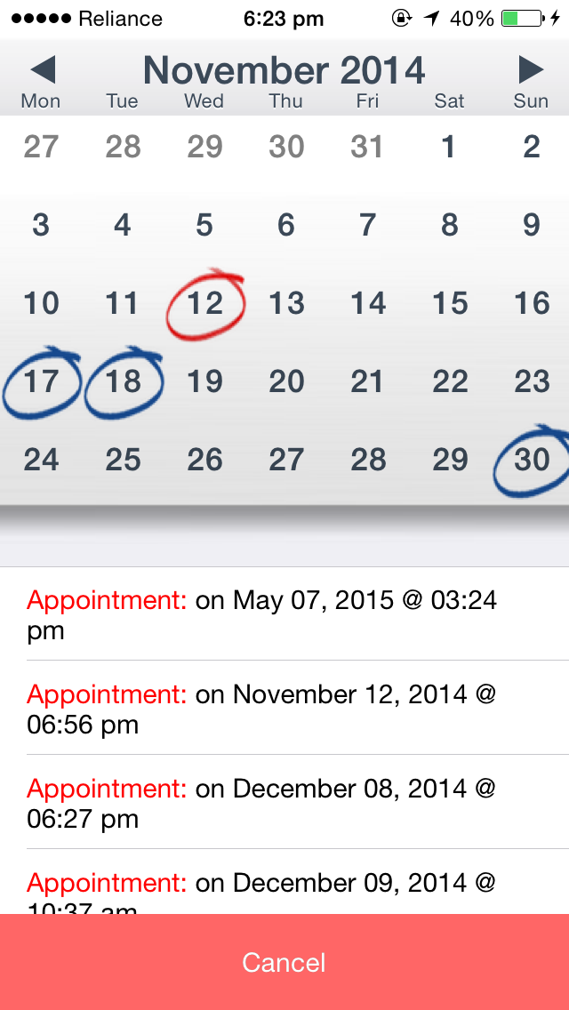
This list does not match with the calendar.
Notes:
I like the red circle, but number also needs to be emphasized either by red color or bold black. What does the blue mean?

Slide 11
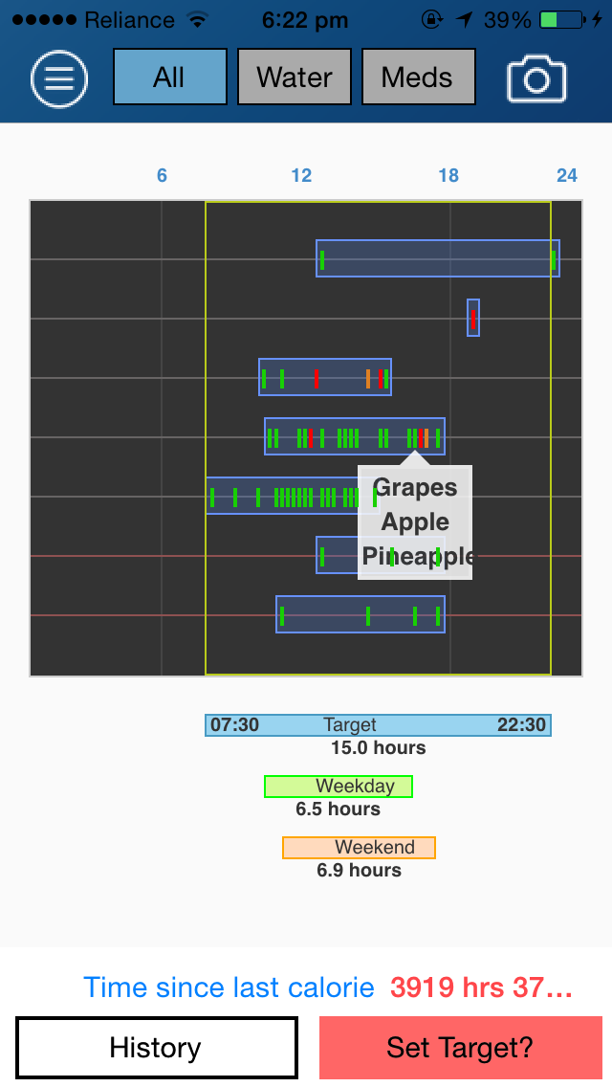
Remove the vertical lines at 6am and 6pm.
Increase the thickness of target lines to make it more prominent.
Show the weekdays and weekends as in the current 3.7 version.
Try to include 2 weeks of data.
Indicate the calculated start and end times for Weekday and “Weekend actual”. They may be outside the box.
“Weekday actual” and “Weekend actual”.
Notes:
I like the shadow box a lot! Not clear what the weekday and weekend hours mean when first looking at this.

Slide 12
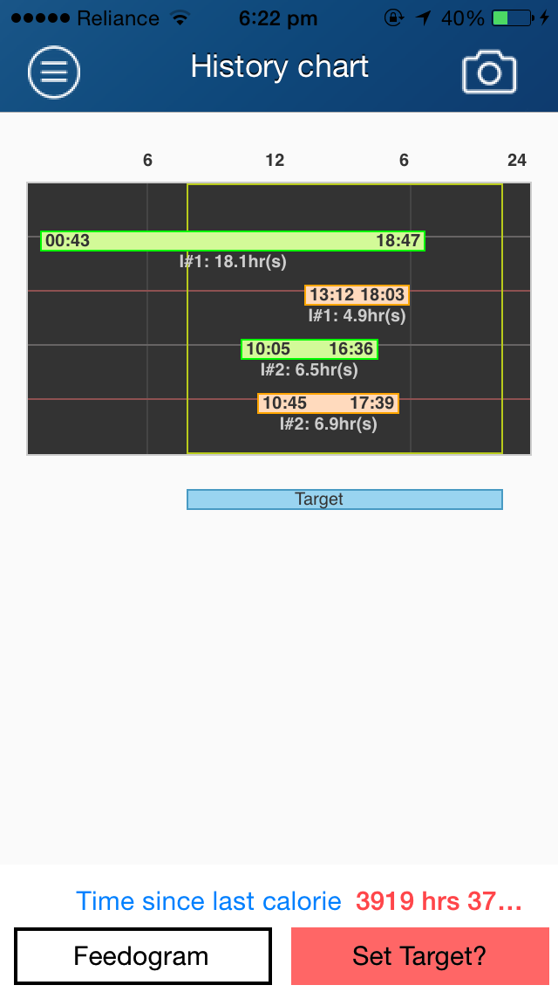
Show the actual dates. 08/02-08/07 XY hr
Show the actual taget here as well. Just like in the previous feedogram page.
Notes:
This is where the weekday/weekend boxes make sense. But what is the first green? Set Target shouldn’t be here?

Slide 13
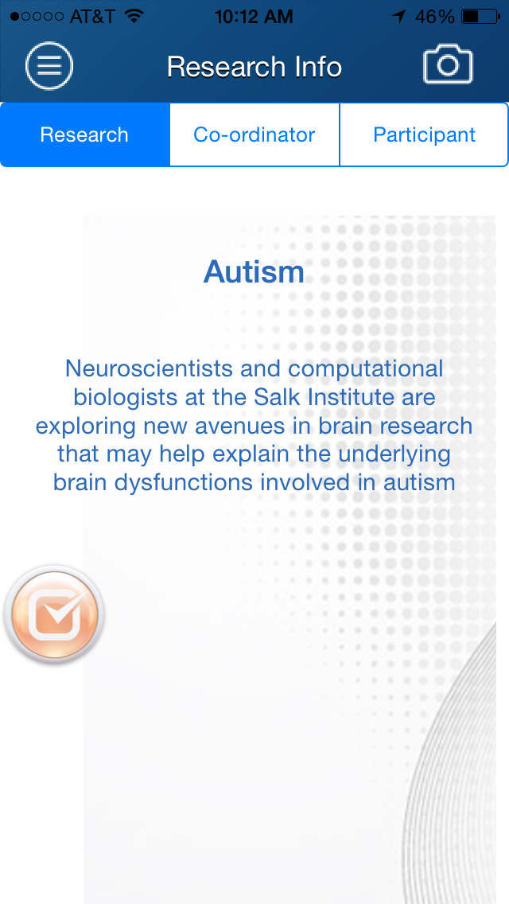
This should only show the “Research Contact Info”. Remove the research and participant info tabs.
Notes:
I suggested replacing this tab with “Research Contact Info” and putting coordinator and PI names and contact email.

Slide 14

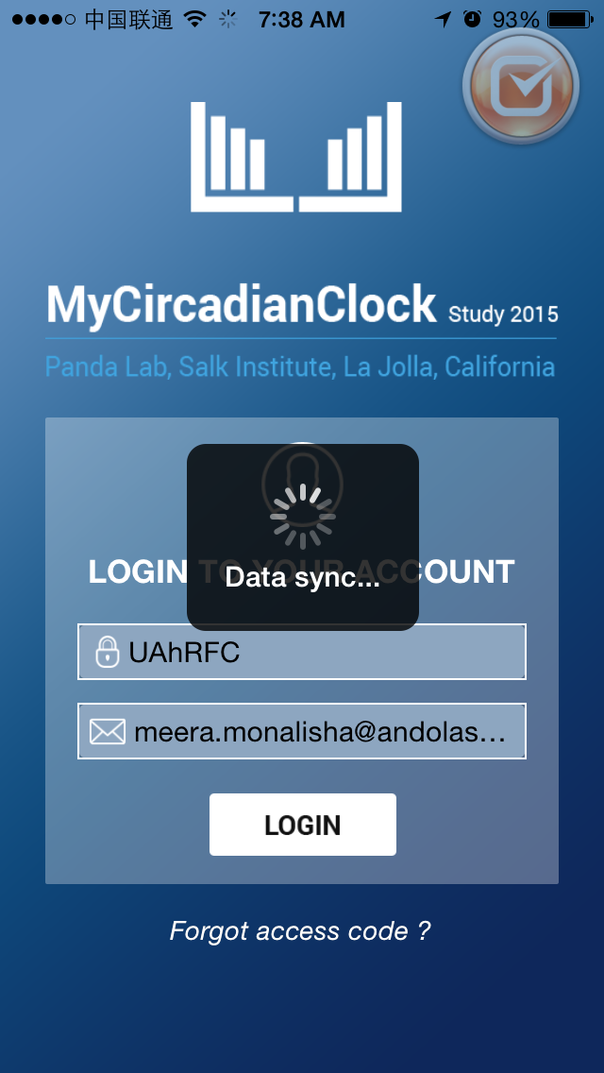
We need to change this text.
Notes:
MyCircadianClock over Salk Circadian. If want to keep text just use last sentence and geo stuff, but a cool pic with the clock ticking around if waiting for download would be better.

Slide 15
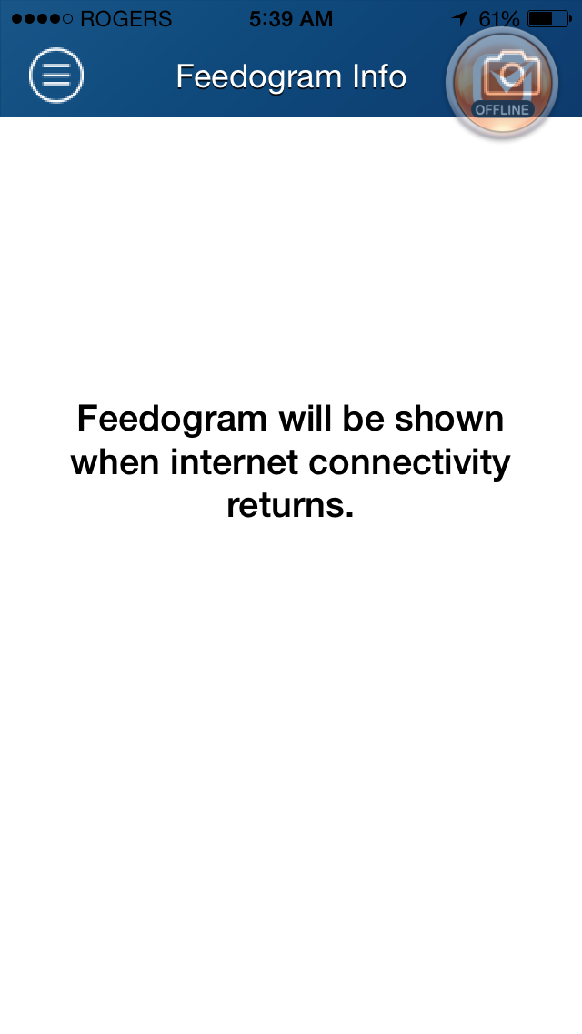

Slide 16
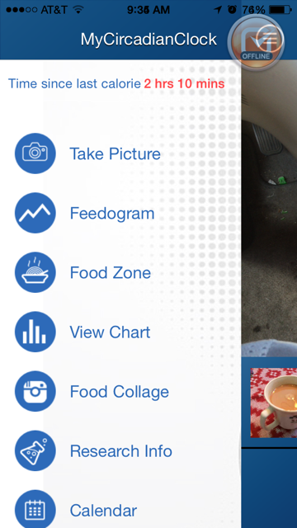
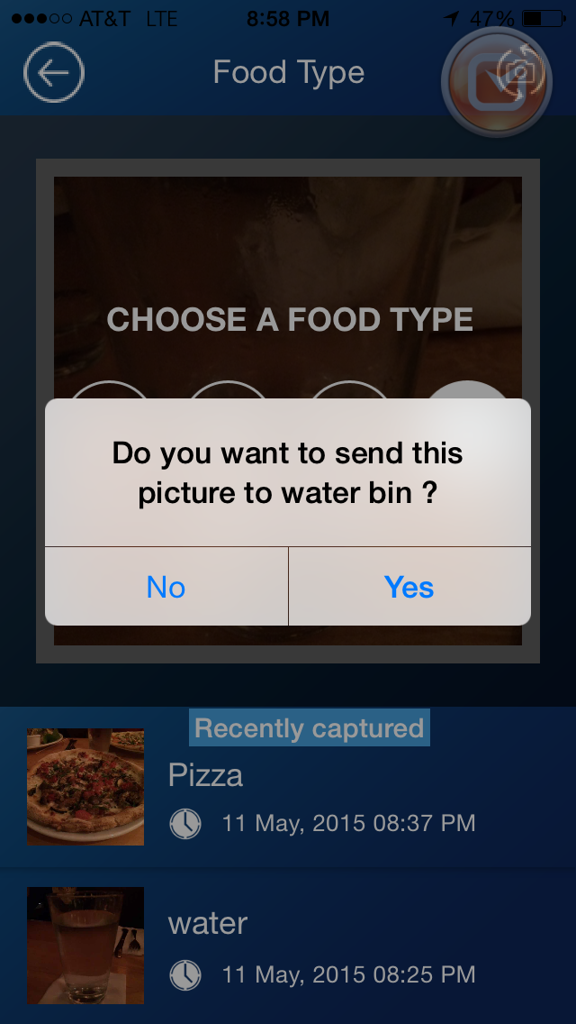
Are you sure this is water? (if soda or other beverage – please use the beverage icon.)
NO YES
Notes:
Like it!

Slide 17
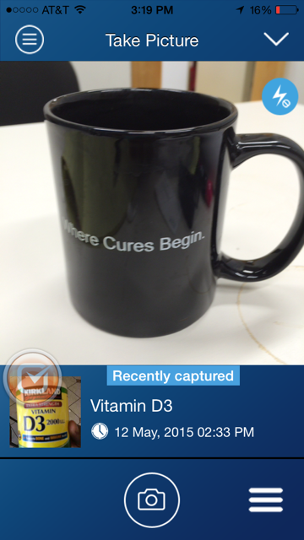
Icons for feedback and reports on feedogram, menu medley, Health parameters (blood glucose, BP, height, weight etc.)”
This area may be better used for daily progress
Icons for LOGGING “Sleep”, “Activity/exercise”, “Health parameters (blood glucose, BP, height, weight etc.)”
Notes:
I wouldn’t put feedback icon right in their face because everyone always has something to say, so if it is really important and not some comment like “this is boring or I like” we shouldn’t put in their face. Health parameters won’t change daily or even weekly so also not in their face unless have the room.

Slide 18
MyCircadianClock
Satchin Panda Lab, Salk Institute,
La Jolla, California, USA
Remove the shaded square
“Synchronizing data with server. It may take several minutes.”
Should we change it to “Activate”
Should we write “Access code: sent to you after signing the consent document.”
Notes:
“La Jolla” is impressive to many in Cali and US, so may consider leaving in there due to people’s desire to participate in something from La Jolla.
I want to see other colors!!!!! I like “Data sync….This may take several minutes” over the long one. I like Activate or Begin Participation better.
They won’t see this until signing the consent doc right? NEED ICON IDEAS!! This will be my weekend goal.

Slide 19





